Slide 1


Boosting Approach to Solving Machine Learning Problems
Intuition Behind Boosting
Implementing Boosting
Boosting Algorithms
How Boosting Work
Dr Sulaimon Afolabi
Notes:
Get the mathmatics animation

Slide 2



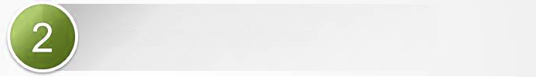

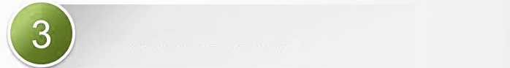


1
Intuition behind boosting algorithms
2
How boosting algorithms work
3
Types of boosting algorithms
4
Features of boosting algorithms
5
Boosting algorithms implementation

Slide 3
1
Intuition behind boosting algorithms
A
Definition of boosting
B
Characteristics of boosting algorithm
C
When to adopt boosting algorithms

Slide 4
A
Definition of boosting
Boosting is a machine learning ensemble algorithm used in supervised learning to create a high performing model by sequentially building models with the performance of the prior model being taken consideration before building the next one.

Slide 5
B
Characteristics of boosting algorithm
Supervised
Learning
Limited to supervised learning problems
– Classification & Regression.
Ensemble
Methods
Employs ensemble method meaning many models are trained and their results combined.
Model Dependence
Models are built sequentially and the next model is
dependent on the prior one.
Ensemble
Weight
Weights are allocated to each model based on the
performance of their respective performance.

Slide 6
C
When to adopt boosting algorithms
Nature of Problem
A problem with known continuous (regression) or
discrete outcome (classification).
High
Performance
Interest in having high performing model
- low bias, low variance.
Scalability
Building models that do not cringe under growing
data volume –capable of distributed computing
Speed
When there is the need for speed
In-built
Function
Algorithm with functionality for handling missing
data, cross-validation and regularisation
Robust
Result
When you desire model whose power to generalise
over unseen data is high & stable overtime.

Slide 7
2
How boosting algorithms work
A
Objective of boosting algorithms
B
Framework of boosting algorithms

Slide 8
A
Objective of boosting algorithms
Regularization
To solve the problem of overfitting with its reg_lambda parameter & consideration of weak learners.
Boosting
Boosting the weak learners i.e. convert the weak learners into to strong learners
Loss
Minimising
To minimize the loss of the model by adding weak learners using a gradient descent like procedure.
Sequential
To sequentially build models and afterwards combine
Them.
Notes:
o improve the performance of the weak learning algorithm while treating it as a “black box”

Slide 9
B
Framework of boosting algorithms

Slide 10
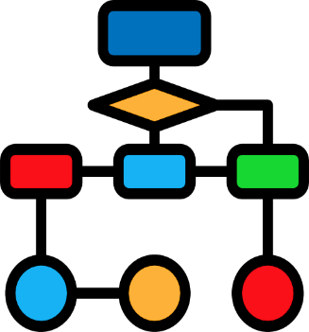

Framework of boosting algorithms
Train Dataset
Random Sampling
(with replacement)
Learning Stage
Results
1
14
7
11
18
10
21
6
28
R1
22
5
9
15
25
10
6
17
23
30
18
24
19
7
R2
Weighted Average of the Results
8
20
29
21
16
28
19
12
26
22
9
14
27
8
4
27
24
2
13
R3

Slide 11
3
Types of boosting algorithms

Slide 12
XGBoost
LightGBM
CatBoost
AdaBoost

Slide 13
4
Features of boosting algorithm types

Slide 14
XGBoost started as a research project by Tianqi Chen as part of the Distributed machine learning community group.
XGBoost is a scalable and flexible boosting algorithms optimised for preforming data science tasks.
XGBoost
XGBoost supports distributed computing and out of core processing for machine learning training purposes.
XGBoost has the capacity for handling missing data and
regularization
https://xgboost.ai
XGBoost based models have won many machine learning
challenges.

Slide 15
Categorical + Boosting (CatBoost) is a boosting algorithm Developed by Yandex researchers and engineers.
CatBoost produces good results even without extensive hyper-parameter tuning.
CatBoost
CatBoost has the inbuilt capacity to handle categorical features even the non-numerical ones.
Catboost offers improved performance as it reduces overfitting when building model.
https://catboost.ai
Catboost is fast and scalable and provides GPU support.

Slide 16
AdaBoost, short for Adaptive Boosting, is a machine learning meta-algorithm formulated by Yoav, Freund and Robert Schapire.
AdaBoost can be less susceptible to the overfitting problem than other learning algorithms.
AdaBoost
AdaBoost is sensitive to noisy data and outliers.
AdaBoost was designed to put more weight on misclassified samples and less weight on correctly classified samples. The final prediction is a weighted average of all the weak learners, where more weight is placed on stronger learners. .
wikipedia.org/wiki/AdaBoost

Slide 17
LightGBM was developed by Microsoft machine learning group.
LightGBM has the capability for distributed computing and has GPU support.
LightGBM
LightGBM is built for model training speed and churning high performing model.
LightGBM is capable on of big data with its in-built parallel computing capacity.
lightgbm.readthedocs.io
LightGBM is optimised for low memory usage

Slide 18
5
Boosting algorithms implementation

Slide 19




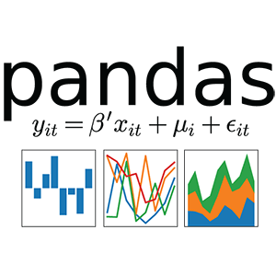
Data
Source
Data
Loading
Data
Visualisation
Model
Building
Model
Evaluation
Log-loss
Pandas
Profiling

